Slide 1

Dark Wolf Hack Our Drone
Introduction

Slide 2
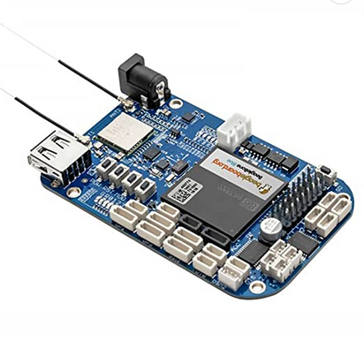
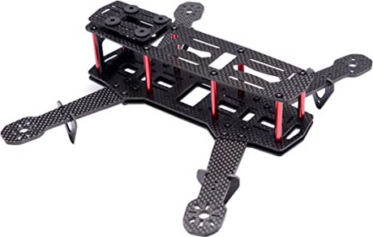
Our UAS: Uncrewed Aerial Vehicle
Ready to Sky 250mm FPV
NEO-6M GPS
12A ESC BLHELI 14.2 Firmware
1806 Motors
Generic “dumb” Power Distribution
2SP1 7.4V 2200mAh 100C LiPo
BeagleBone Blue Flight Computer
Debian 10 IoT
AM335x 1GHz ARM Cortex-A8 processor 512MB DDR3 RAM
RTU

Slide 3
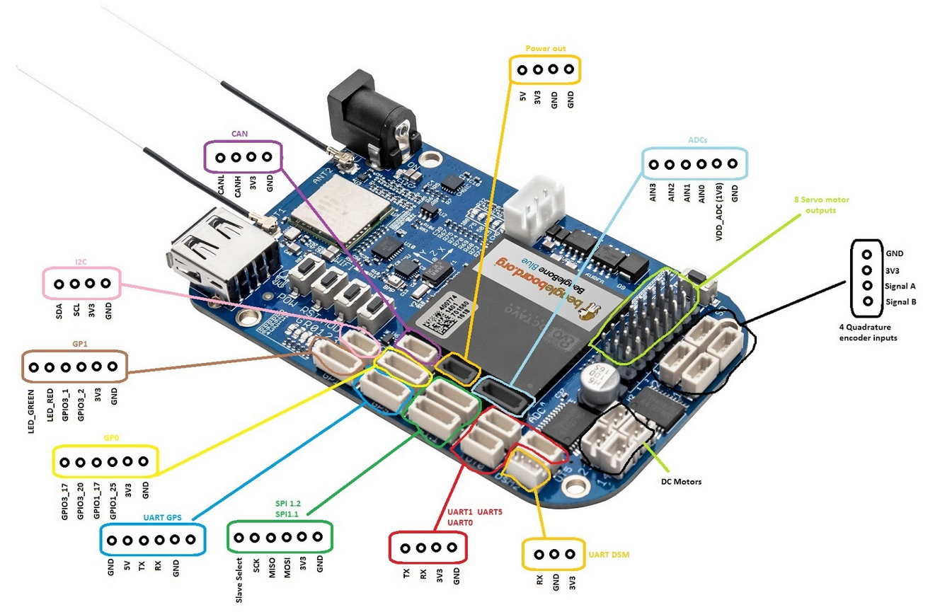
Beagle Bone Blue: Flight Computer

Slide 4

Our UAS: Ground Control System
Wuzcon Game Controller
PS4 Dual Shock Clone
Wired Joystick Input
Huawei Nexus 6P
Android 8.1.0

Slide 5
A Few Words About Security Testing

Slide 6
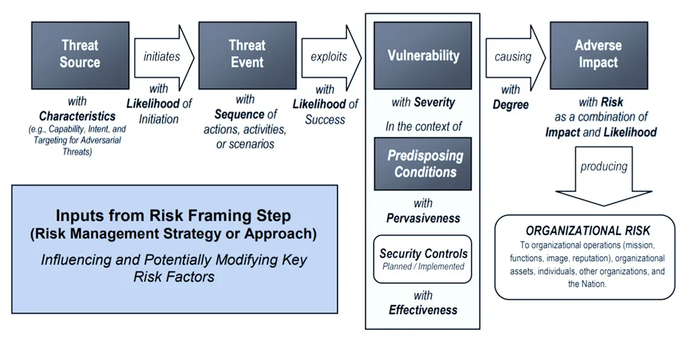
Threat Modeling
Generic Risk Model with Key Risk Factors (NIST SP 800-30 R1)
https://wentzwu.com/2019/08/26/the-nist-generic-risk-model/

Slide 7
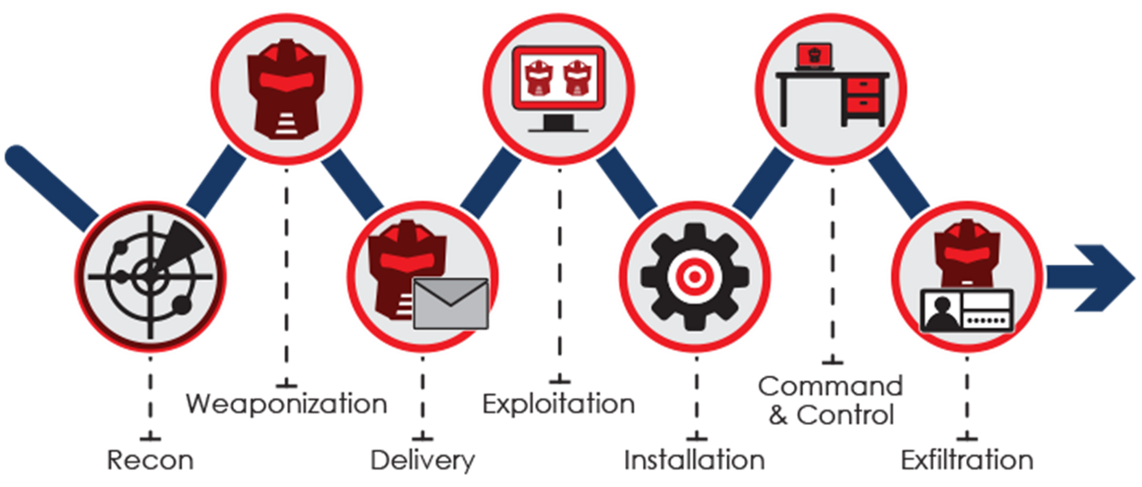
Intro: Cyber Kill Chain
Cyber Kill Chain
Attacks involve a series of tasks
Understanding those tasks help defenders anticipate and harden vulnerable systems
Understanding those tasks help testers to evaluate risk associated with enumerated vulnerabilities

Slide 8


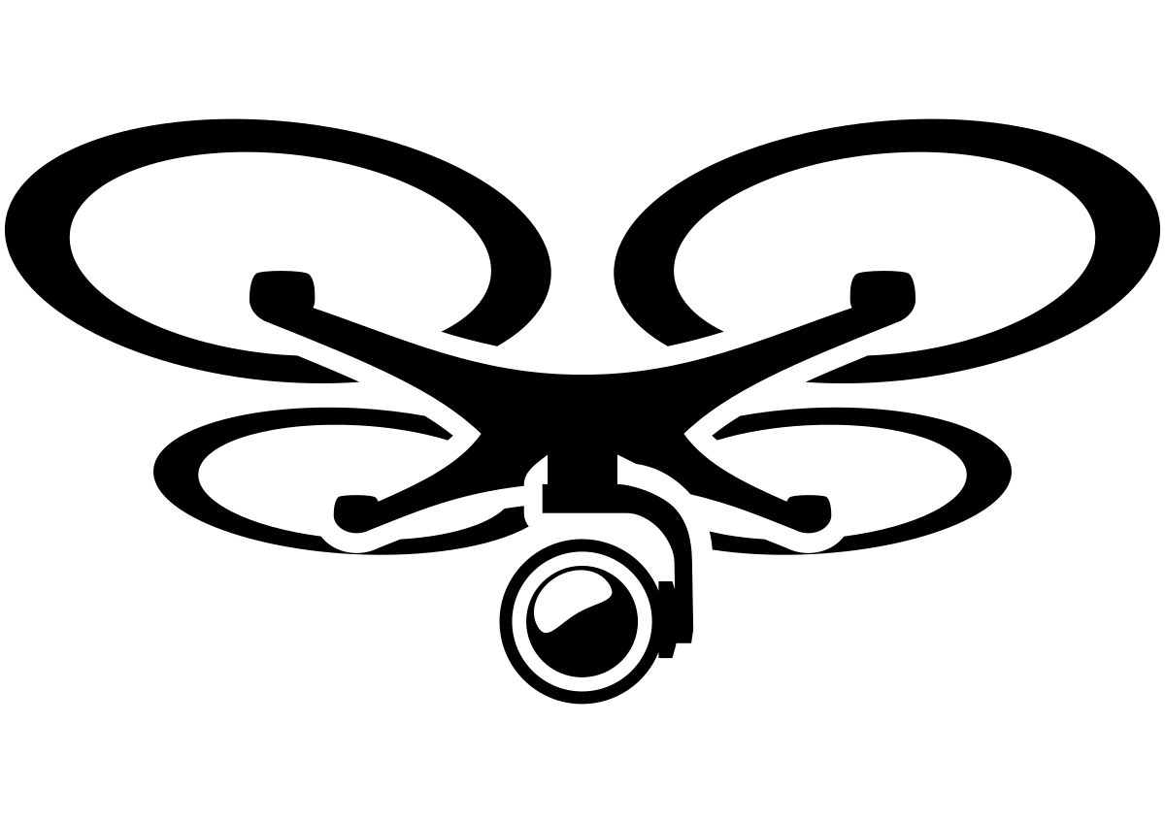


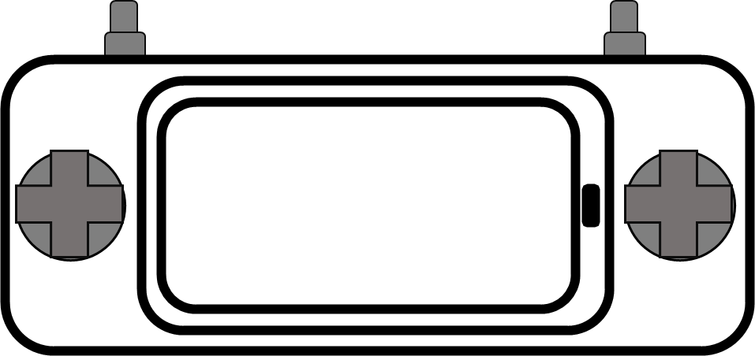

System Decomposition and Interfaces
Hardware
UAV
GCS
Telemetry Radio
RC Radio
Payload
Software
Flight Software / Firmware
Supply Chain
Software Libraries
Sensors
GPS
ADS-B
DroneID
Services
Cloud
GPS
ADS-B
RF
Wifi
Supply Chain
RF
Wifi
Software Libraries

Slide 9
Work Shop

Slide 10
Ground Rules
UAV: Don’t power from two sources
You can power from Micro USB interface on the front of the BeagleBone
If you power from the LiPo, be very careful with the direction of the plugs
You can short the Battery Input on the board
GCS:
To connect to the ArduPilot flight software
Connect to the WiFi that matches your UAV
Set a static IP address of 192.168.8.150 on the phone Modules: Aiming for 30 minutes for each module
Work in pairs
Kali Linux or Windows

Slide 11
Workshop Lab Modules
Module 1: Ground Control System
Task 1: Extract Files
Task 2: Analyze Firmware
Task 3: Identify WiFi Password
Module 2: Unmanned Aerial Vehicle
Task 1: Access the UAV
Task 2: Escalate Privilege
Task 3: Root and Loot
Module 3: Communications
Task 1: Collect 802.11 traffic
Task 2: Crack WiFi password
Task 3: Monitor MAVLink Traffic

